Slide 1
Getting Started with Java Modules

Slide 2
Contents
Getting started with Java modules
Defining a simple modular application
Defining a simple modular JAR

Slide 3
1. Getting Started with Java Modules
Overview
Java API refactored into modules
Benefits of JPMS

Slide 4
Overview
Java 9 introduced "modules", a new way to organize code
Via the Java Platform Module System (JPMS)
Previously codenamed Project Jigsaw
JPMS allows you to bundle up your Java packages into a cohesive unit called a "module"
A Java module specifies:
What packages it makes visible to other modules
What other modules it requires, to do its thang dude

Slide 5
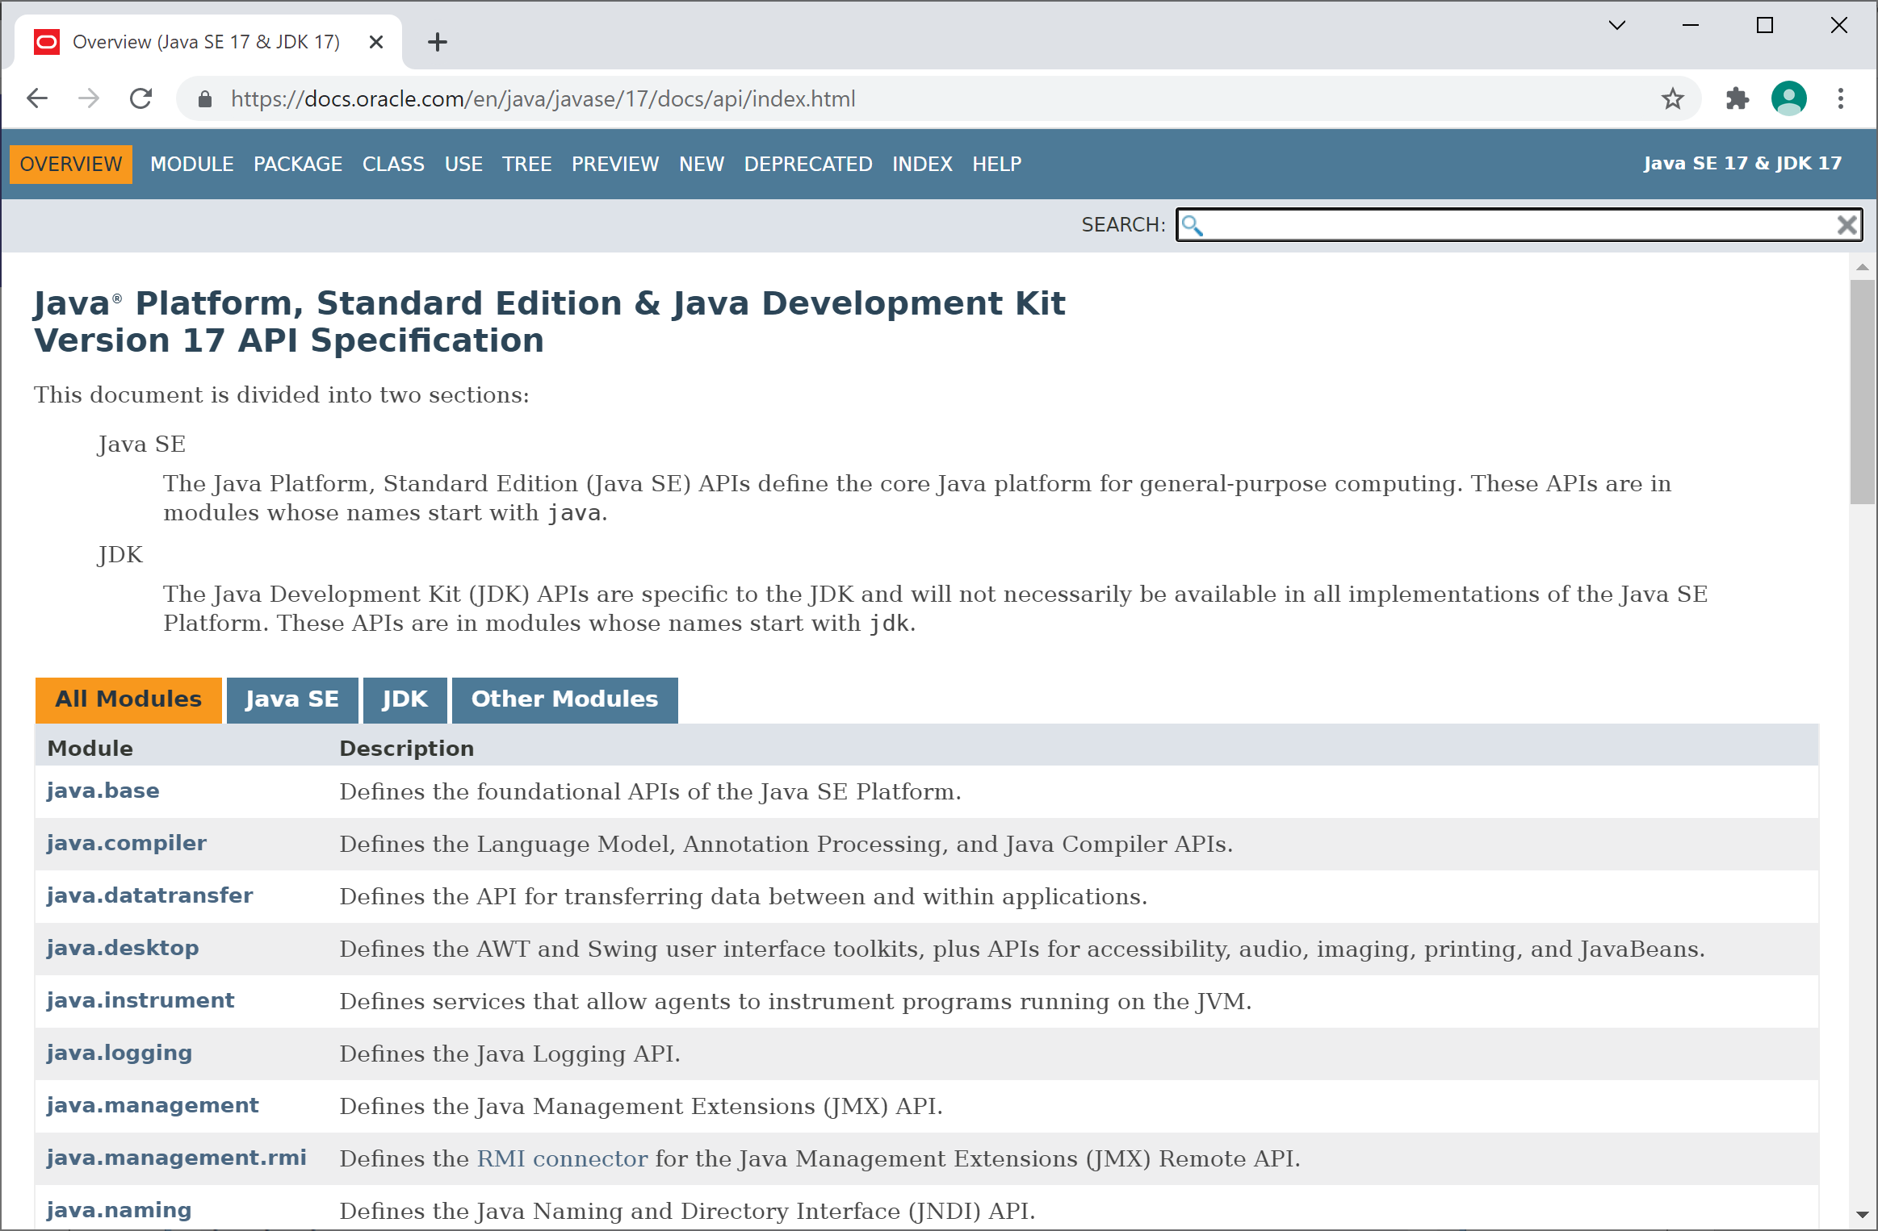
Java API Refactored into Modules
The Java API has been refactored into modules
Take a look at JavaDoc
E.g. https://docs.oracle.com/en/java/javase/17/docs/api

Slide 6
Benefits of JPMS
Smaller application distributeables
You can specify which Java modules you need in your application
Java can bundle up your app including just the modules you need
Can dramatically reduce the size of your application distributeable
Encapsulation of internal packages
You must explicitly specify which packages are exported
You can choose not to export some packages
This gives you another level of encapsulation in your system
The JVM detects missing modules at start-up
The JVM will shut down immediately if any modules are not found
Previously, missing classes/JARs were only detected when used

Slide 7
2. Defining a Simple Modular Application
Module toolset
How to define a module
Example
Compiling modules
Executing a modularized application
Creating and running a modularized JAR

Slide 8
Module Toolset
In this chapter we'll focus on how to define and run modules at the command line
So you understand the JDK/JRE options, from first principles
If you're using IntelliJ, bear the following points in mind:
Each Java module must live in a separate IntelliJ module
If one module "requires" another, you need to define a relationship between the IntelliJ modules
(E.g. see demo.moduleB etc. in IntelliJ)

Slide 9
How to Define a Module
A module is a unit of software that defines:
A module name, e.g. com.osl.mycoolmodule
What packages does it export?
What other modules does it require?
A module defines this info in module-info.java
This file lives in a directory with the same name as the module
Typically at the root of your code packages

Slide 10
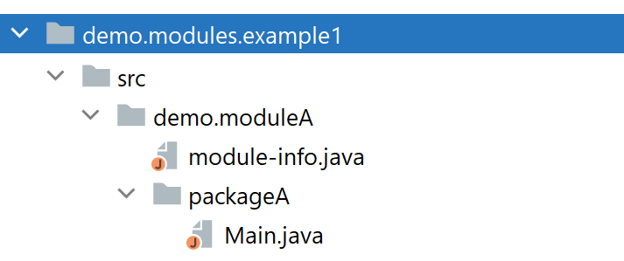
Example (1 of 3)
For a simple module example, see this demo folder:
The example has a single module named demo.moduleA
Info about the module is defined in module-info.java
The code for the module is in a package named packageA
A module name should be globally unique
E.g. use a reverse-domain-name for the module
Also consider giving the same name to the primary package

Slide 11
Example (2 of 3)
Here's the module-info.java file in our module:
module demo.moduleA {
exports packageA;
}
demo.moduleA/module-info.java

Slide 12
Example (3 of 3)
Our application contains a simple "main" class
package packageA;
public class Main {
public static void main(String[] args) {
System.out.println("Hello from my modularized Java app!");
}
}
demo.moduleA/packageA/Main.java

Slide 13
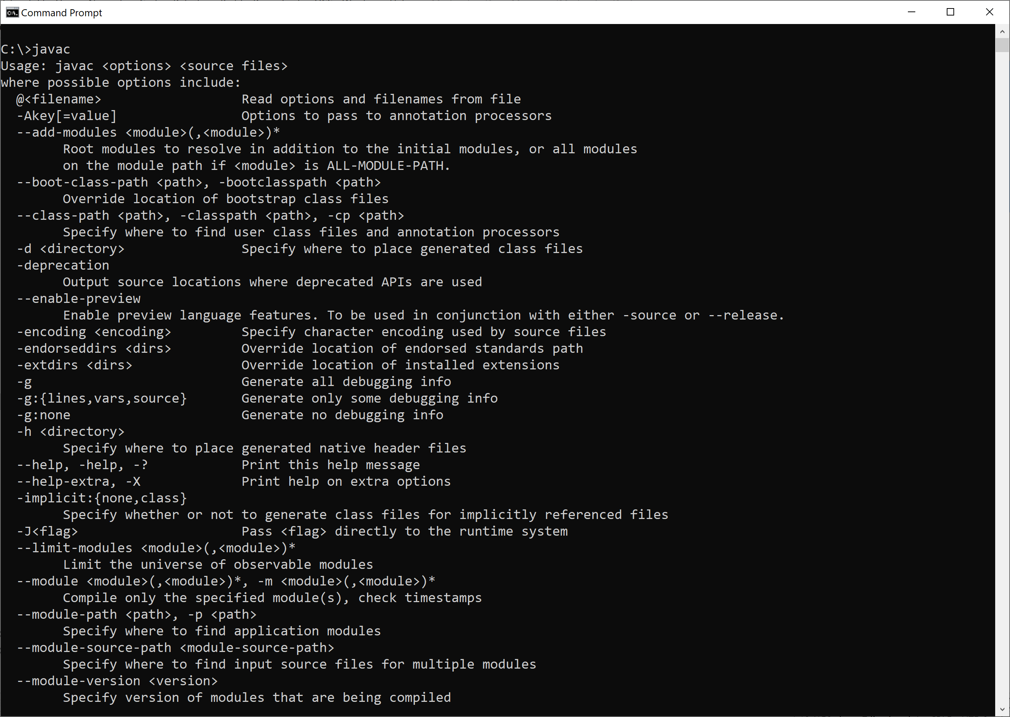
Compiling Modules (1 of 2)
The Java compiler has new flags for modules:

Slide 14
Compiling Modules (2 of 2)
Here's the command to compile our module
Available in compile.cmd
--module-source-path
Specifies location of our module source code
--module
Specifies which module(s) to compile
-d
Specifies output directory for compiled Java classes
javac --module-source-path src --module demo.moduleA -d out

Slide 15
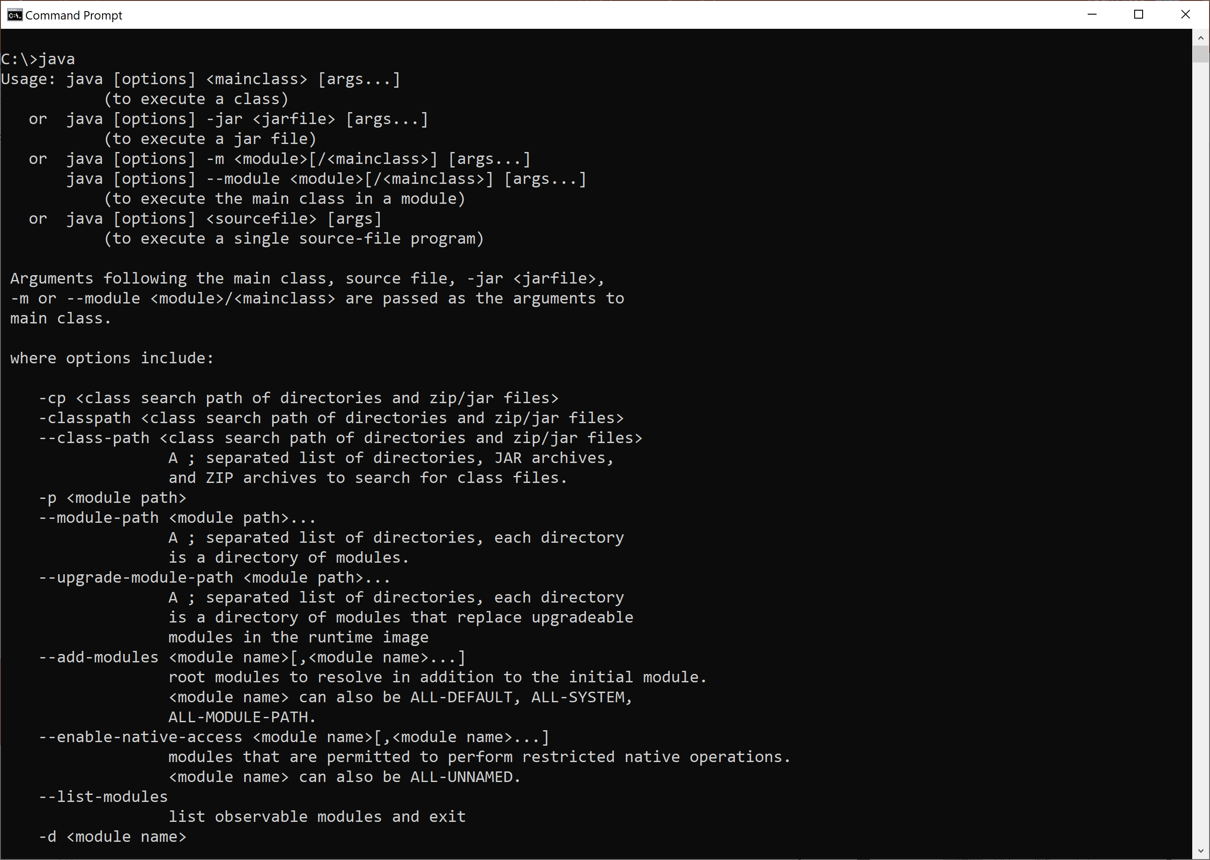
Executing a Modularized Application (1 of 2)
The JVM has new flags for executing modules:

Slide 16
Executing a Modularized Application (2 of 2)
Here's the command to execute our modularized app
Available in execute.cmd
--module-path
Specifies location of our compiled modules
--module
Specifies which module to run, and which particular class
Could just use -m for short
java --module-path out --module demo.moduleA/packageA.Main

Slide 17
3. Defining a Simple Modular JAR
Creating a modular JAR
Executing a modular JAR
Designating the entry point in a modular JAR

Slide 18
Creating a Modular JAR
You can bundle a module into a "modular JAR"
Just use the jar tool (has module-related options in Java 9+)
Here's how to create a modularized JAR
Available in jarCreate.cmd
c tells jar to create a new JAR file
f specifies the path/name of the JAR file to create
-C tells jar to change to the (compiled) module root directory
. grabs the files in that directory
md out-jar
jar cf out-jar/com-osl-myjar.jar -C out/demo.moduleA .

Slide 19
Executing a Modular JAR
Here's how to run a modular JAR
Available in jarExecute.cmd
--module-path - adds the JAR to the module path
--module - specifies which module (and class) to run
java --module-path out-jar --module demo.moduleA/packageA.Main

Slide 20
Designating the Entry Point in a Modular JAR
You can designate the entry point for a modular JAR
Use the e option
See jarCreateWithMain.cmd
To run a modular JAR with a designated entry point…
Just like running a normal JAR
No need for any module-related options now
See jarExecuteWithMain.cmd
md out-jar
jar cfe out-jar/com-osl-myjar.jar packageA.Main -C out/demo.moduleA .
java -jar out-jar/com-osl-myjar.jar

Slide 21
Any Questions?

